Slide 1
AZERBAIJAN STATE OIL AND INDUSTRY UNIVERSITY
FACULTY: ITIF
GROUP: 604.20E
TEACHER: SEVINJ KARIMOVA
STUDENT: GUNEL HUMBATOVA
SUBJECT: OPERATING SYSTEMS
SYSTEM SECURITY. CRYPTOGRAPHY AS A SECURITY TOOL

Slide 2
Plan: 1.Cryptography – What is Cryptography? 2.System Security 3. System Security – Firewall 4. System Security-Encription 5. System Security – Password

Slide 3

CRYPTOGRAPHY
What is Cryptography?

Slide 4
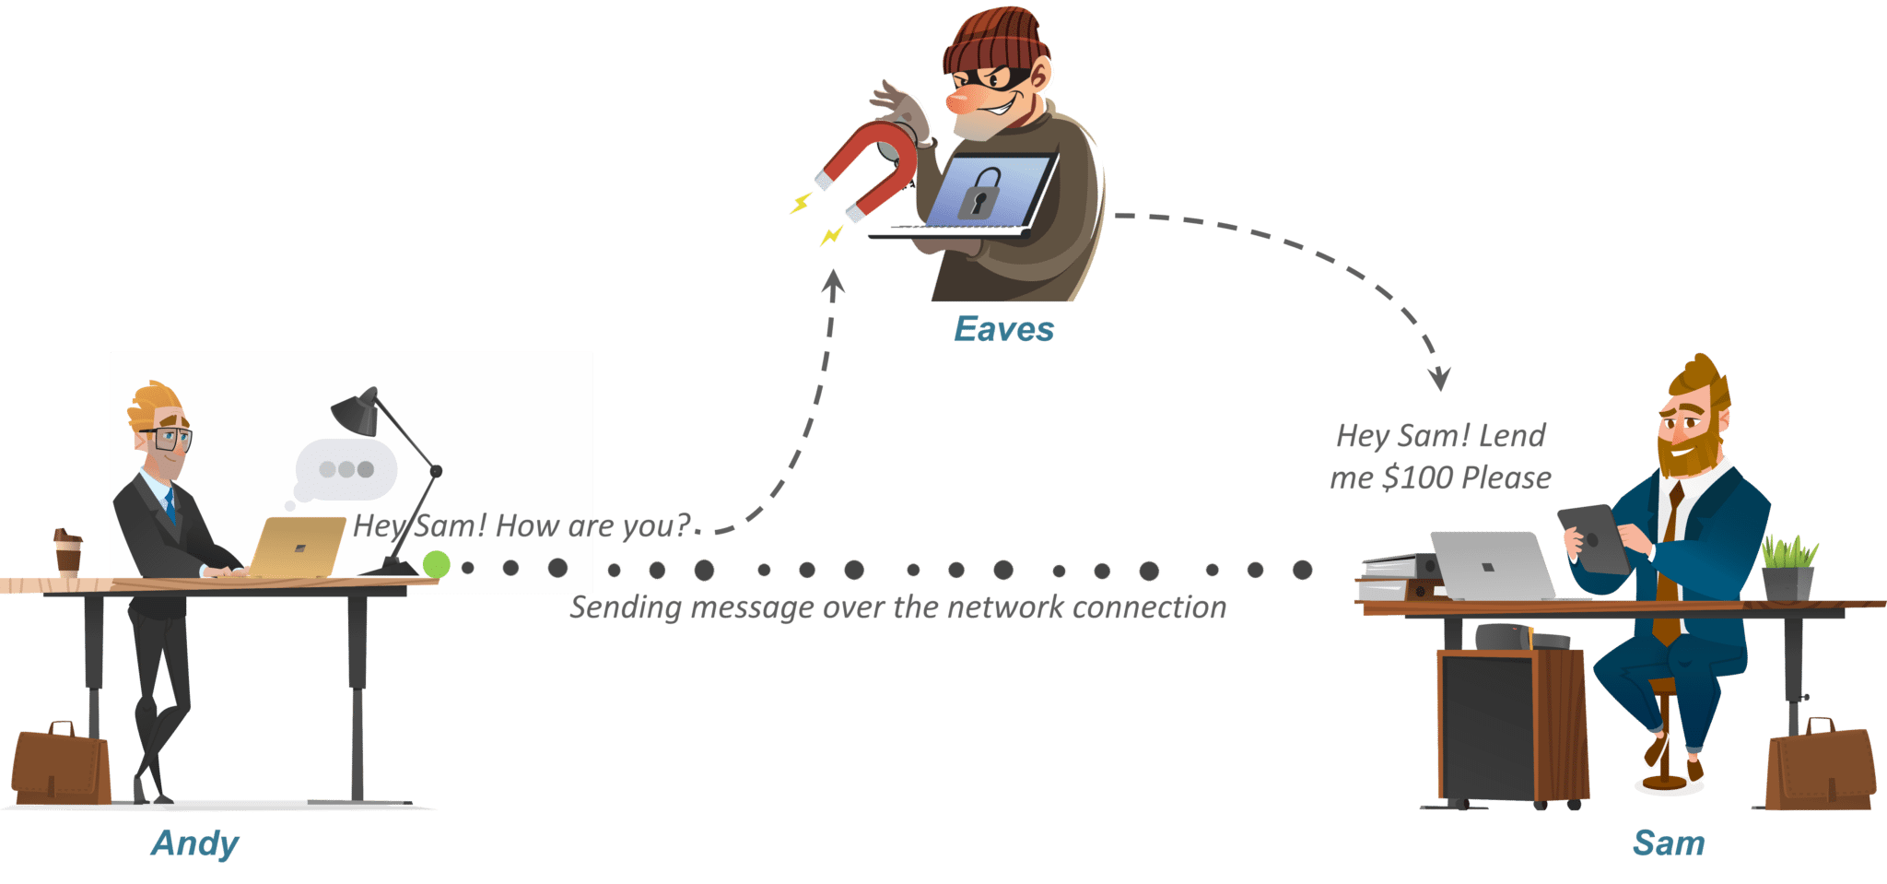
What is Cryptography?
Let’s say there’s a person named Andy. Now suppose Andy sends a message to his friend Sam who is on the other side of the world. Now obviously he wants this message to be private and nobody else should have access to the message. He uses a public forum, for example, WhatsApp for sending this message. The main goal is to secure this communication.

Slide 5
What is Cryptography?
Let’s say there is a smart guy called Eaves who secretly got access to your communication channel. Since this guy has access to your communication, he can do much more than just eavesdropping, for example, he can try to change the message. Now, this is just a small example. What if Eave gets access to your private information? The result could be catastrophic.
So how can Andy be sure that nobody in the middle could access the message sent to Sam? That’s where Encryption or Cryptography comes in.

Slide 6
What is Cryptography?
“Cryptography is the practice and study of techniques for securing communication and data in the presence of adversaries. ”

Slide 7
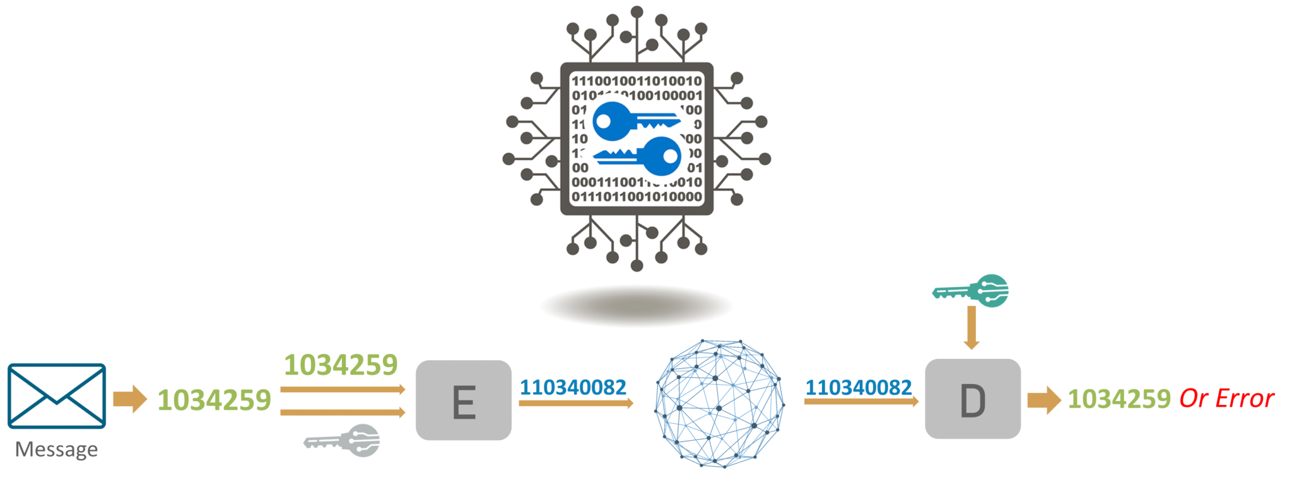

Slide 8
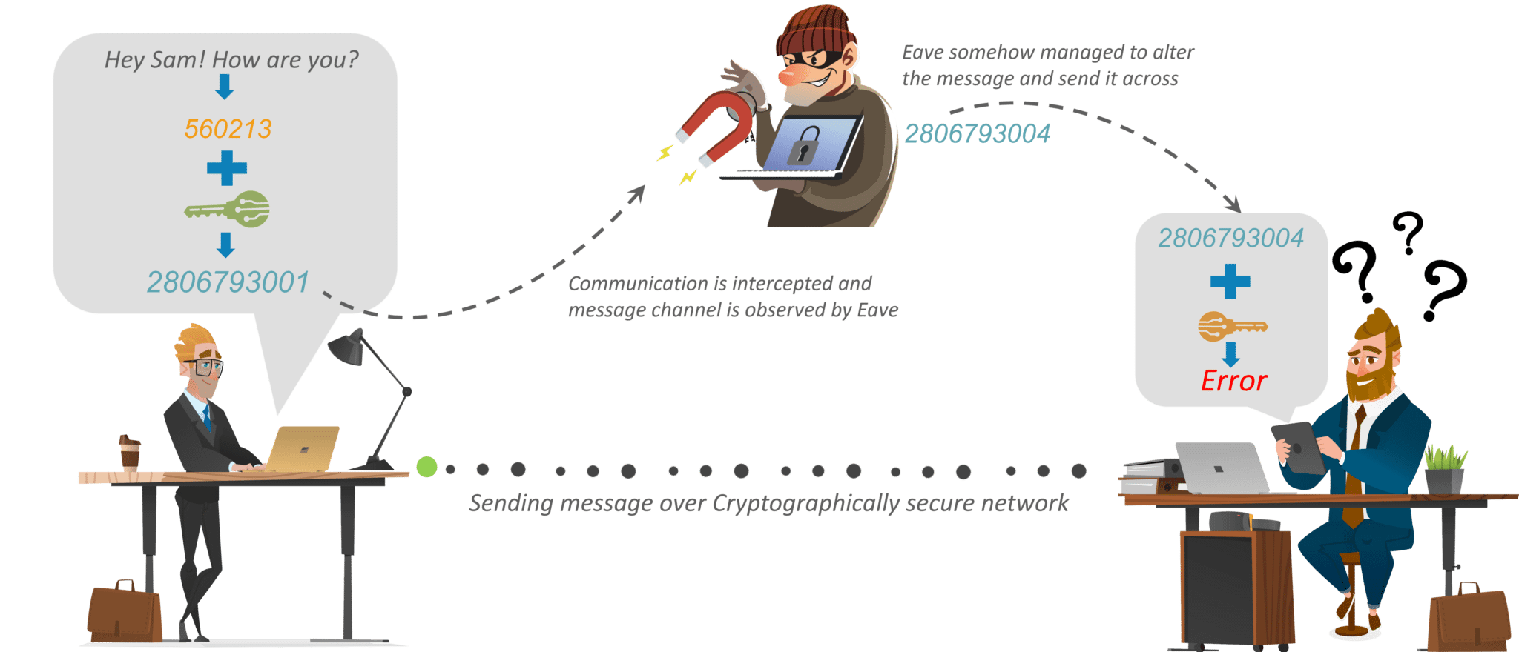
Now, Sam would need a key to decrypt the message to recover the original plaintext. In order to convert the ciphertext into plain text, Sam would need to use the decryption key. Using the key he would convert the ciphertext or the numerical value to the corresponding plain text.

Slide 9
Let’s see how cryptography can help secure the connection between Andy and Sam.
So, to protect his message, Andy first convert his readable message to unreadable form. Here, he converts the message to some random numbers. After that, he uses a key to encrypt his message, in Cryptography, we call this ciphertext.
Andy sends this ciphertext or encrypted message over the communication channel, he won’t have to worry about somebody in the middle of discovering his private messages. Suppose, Eaves here discover the message and he somehow manages to alter it before it reaches Sam.

Slide 10
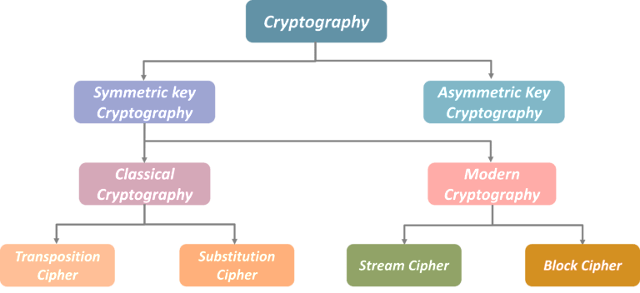
Encryption Algorithms Cryptography is broadly classified into two categories: Symmetric key Cryptography and Asymmetric key Cryptography (popularly known as public key cryptography).

Slide 11


SYSTEM SECURITY
Security of a computer system is a crucial task. It is a process of ensuring confidentiality and integrity of the OS. A system is said to be secure if its resources are used and accessed as intended under all the circumstances, but no system can guarantee absolute security from several of the various malicious threats and unauthorized access.
The objective of system security is the protection of information and property from theft, corruption and other types of damage, while allowing the information and property to remain accessible and productive. System security includes the development and implementation of security countermeasures. There are number of different approaches to computer system security, including the use of a firewall, data encryption, passwords and biometrics.

Slide 12
FIREWALL
SYSTEM SECURITY
One widely used strategy to improve system security is to use a firewall. A firewall consists of software and hardware set up between an internal computer network and the Internet. A computer network manager sets up the rules for the firewall to filter out unwanted intrusions. These rules are set up in such a way that unauthorized access is much more difficult.
A system administrator can decide, for example, that only users within the firewall can access particular files, or that those outside the firewall have limited capabilities to modify the files. You can also set up a firewall for your own computer, and on many computer systems, this is built into the operating system.

Slide 13

ENCRiPTION
One way to keep files and data safe is to use encryption. This is often used when data is transferred over the Internet, where it could potentially be seen by others. Encryption is the process of encoding messages so that it can only be viewed by authorized individuals. An encryption key is used to make the message unreadable, and a secret decryption key is used to decipher the message.
Encryption is widely used in systems like e-commerce and Internet banking, where the databases contain very sensitive information. If you have made purchases online using a credit card, it is very likely that you've used encryption to do this.

Slide 14
PASSWORDS
SYSTEM SECURITY
The most widely used method to prevent unauthorized access is to use passwords. A password is a string of characters used to authenticate a user to access a system. The password needs to be kept secret and is only intended for the specific user. In computer systems, each password is associated with a specific username since many individuals may be accessing the same system.
Good passwords are essential to keeping computer systems secure. Unfortunately, many computer users don't use very secure passwords, such as the name of a family member or important dates - things that would be relatively easy to guess by a hacker. One of the most widely used passwords - you guessed it - 'password.' Definitely not a good password to use.

Slide 15
RESOURCES
https://www.edureka.co/blog/what-is-cryptography/
https://www.cisco.com/c/en/us/products/security/what-is-it-security.html#~types-of-it-security
https://study.com/academy/lesson/systems-security-firewalls-encryption-passwords-biometrics.html
https://its.unl.edu/bestpractices/system-security#:~:text=System%20security%20encompasses%20all%20facets,to%20mitigate%20various%20security%20concerns.

Slide 16


THANK YOU!

